Slide 1




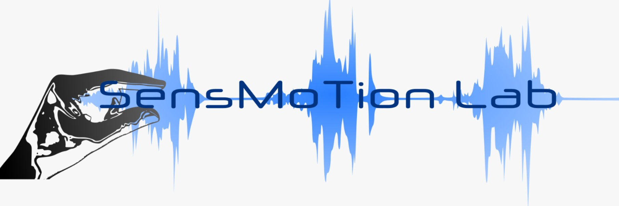


Deep learning in reach movement
James Mathew

Slide 2
Today’s talk
Introduction
Previous works (DL in reach movements)
Synthetic data from computational model simulations
Neural data from deep brain recordings
Synthetic Data - Simulated reach parameters using LQG
CNN-Auto decoder model for reach trajectory generation
Auto encoding & decoding
CNN- LSTM model for reach trajectory generation
Open loop
Closed loop with sensory feedback and offline adaptation
Closed loop with sensory feedback and online adaptation
Neural data / Implementation
Summary

Slide 3
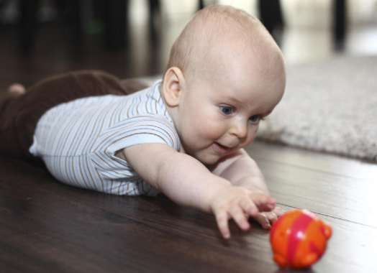
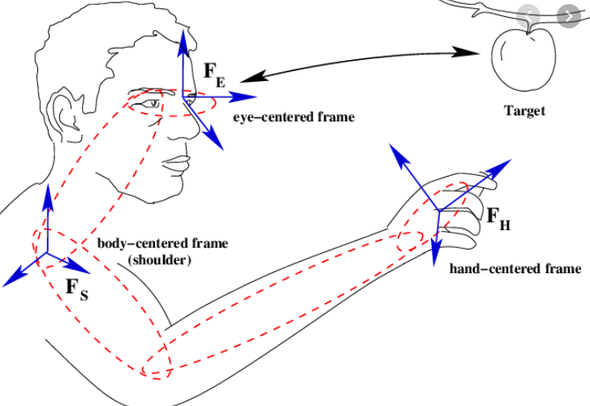
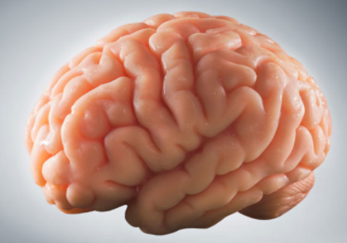
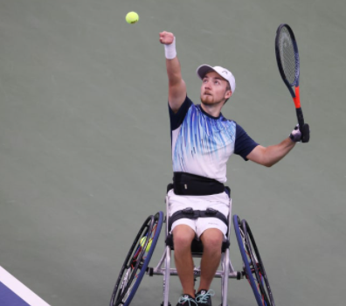
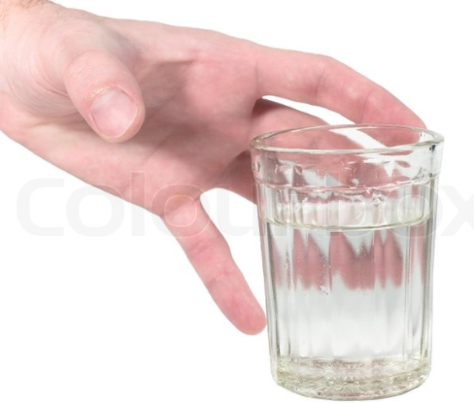
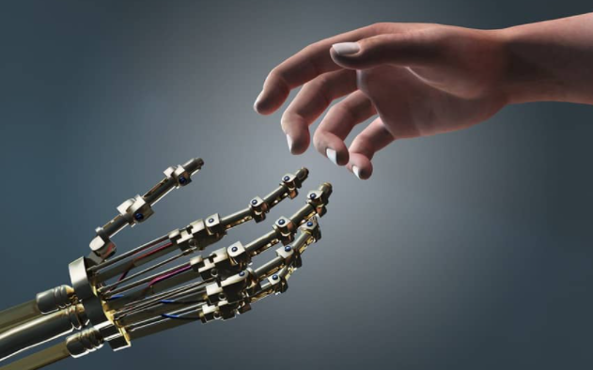

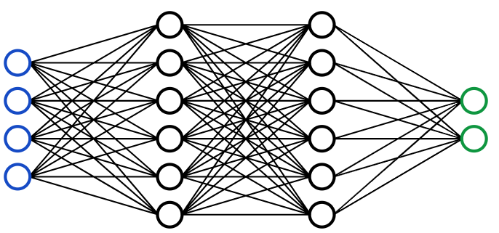
Hand reaching movements : Neural nets / Brain
Input
Output
Visual / neural
Hand behavior
Feedback
Input
Mathematical model
LQG controller
Output
Coordinates
Hand trajectory
Input
Output
Synthetic data
Simulated behavior

Slide 4
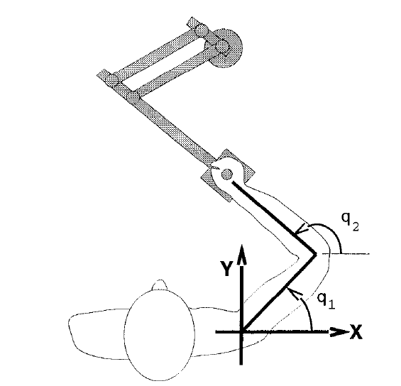
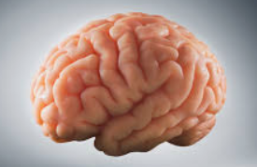
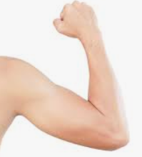
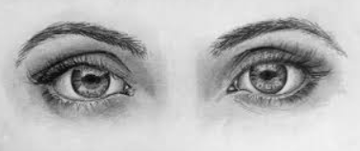
Reach movement – Laboratory settings
Start-end coordinate /initial state
Motor command vector
Trajectory dynamics

Slide 5
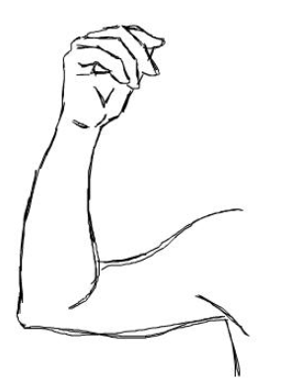
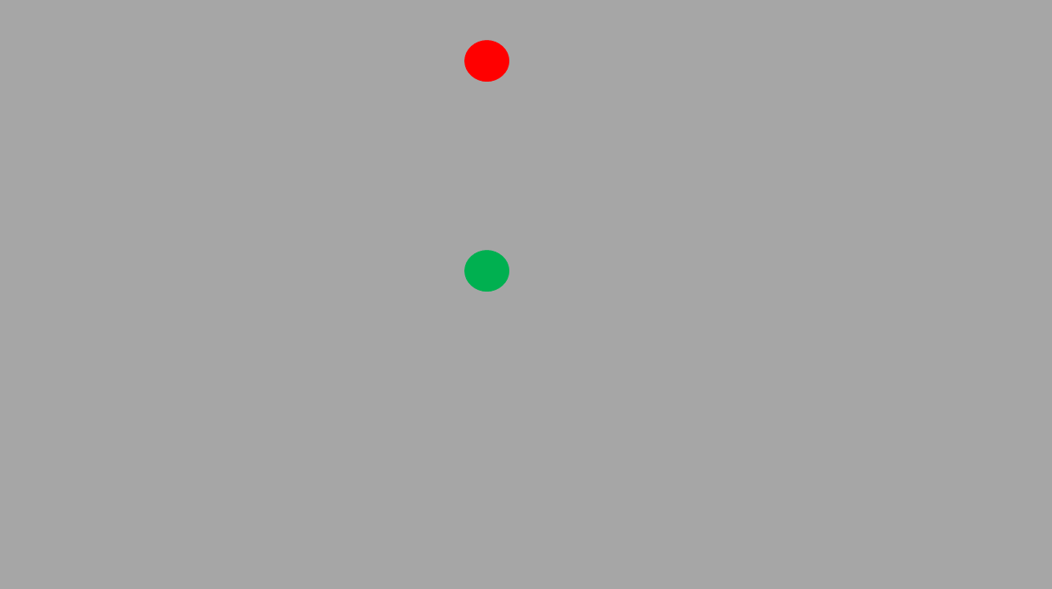
Low and high level flowchart of reaching movement generation
Preprogrammed/goal directed tasks OR
Dynamic/tracking tasks
Input:
Neuron firing rate
Output:
Neuron firing rate
X-Y position/ velocity
Motor Cortical pathways
Neural
Level
Sensory Feedback
Visual pathways
Spinal & muscular level
Input:
Start-End
coordinates
Output:
X-Y position/ velocity
Muscle Activation EMG
Behavioural Level
Output:
Movement trajectory
Input:
Task Image

Slide 6
Low and high level flowchart of reaching movement generation
Time invariant/goal directed
Input:
Neuron firing rate
Output:
Neuron firing rate
X-Y position/ velocity
Motor Cortical pathways
Neural
Level
Visual pathways
Spinal & muscular level
Input:
Start-End
coordinates
Output:
X-Y position/ velocity
Muscle Activation EMG
Behavioural Level
Output:
Movement trajectory
Input:
Task Image

Slide 7
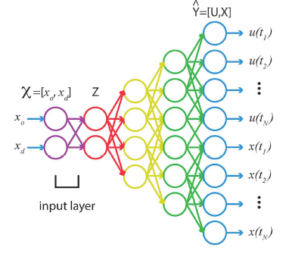
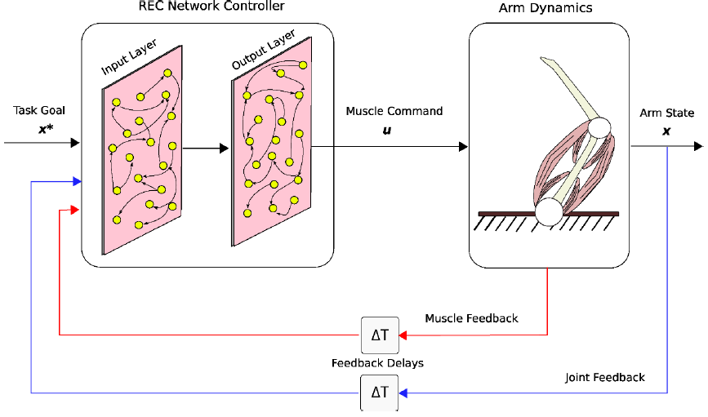
Neural network model of reaching movement from computational models
Autodecoder net
Kalidindi, Scott (2020)
Bernicker & Kording 2015
Task- XY Position-Autoencoder- Motor Command-Trajectory
Task- XY Position (Sensory FB)-RNN- Motor command-Trajectory

Slide 8
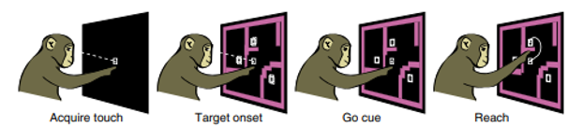
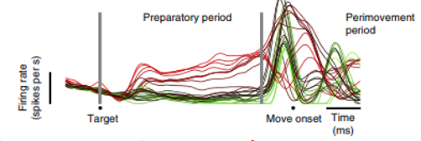
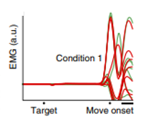
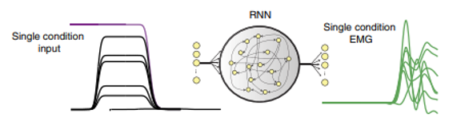
Neural network model of reaching movement from neuronal recordings
Susillo et al 2015, Nature
Task-Neural recordings- PCA-RNN-EMG

Slide 9
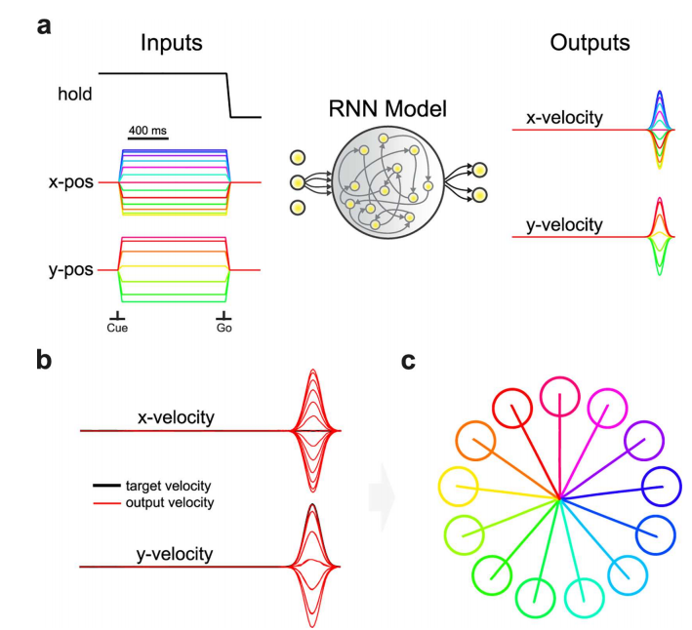
Neural network model of reaching movement from neuronal models
Jonathan et al 2015,2016
Task- XYpos- RNN- XY Velocity- Trajectory

Slide 10
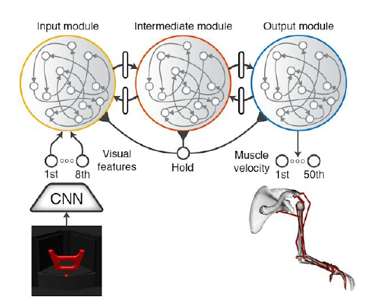
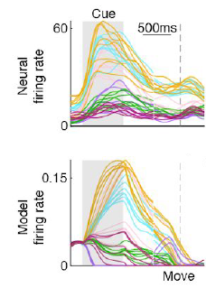
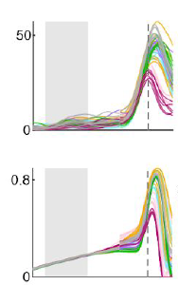
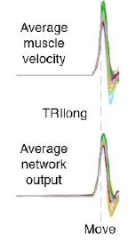
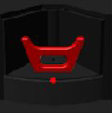
Neural network model of reaching movement from neuronal recordings
AIP
F5
M1
Object
AIP
M1
Muscle
Jonathan et al 2020
TaskImage – CNN-Visual features-RNN- Muscle Velocity- Behavior
A visuomotor gradient from AIP to F5 to M1 that transforms visual features of objects into muscle kinematic signals
These provide snapshots in time and cannot explain the temporal evolution of neural population activity nor the computational mechanisms required to complete the task.

Slide 11
Today’s talk
Introduction
Previous works
Synthetic data from computational model simulations
Neural data from deep brain recordings
Synthetic Data - Simulated reach parameters using LQG
CNN-Auto decoder model for reach trajectory generation
Auto encoding & decoding
CNN- LSTM model for reach trajectory generation
Open loop
Closed loop with sensory feedback and offline adaptation
Closed loop with sensory feedback and online adaptation
Neural data / Implementation
Summary

Slide 12
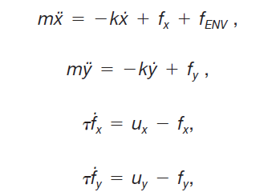
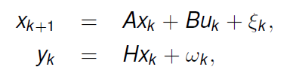
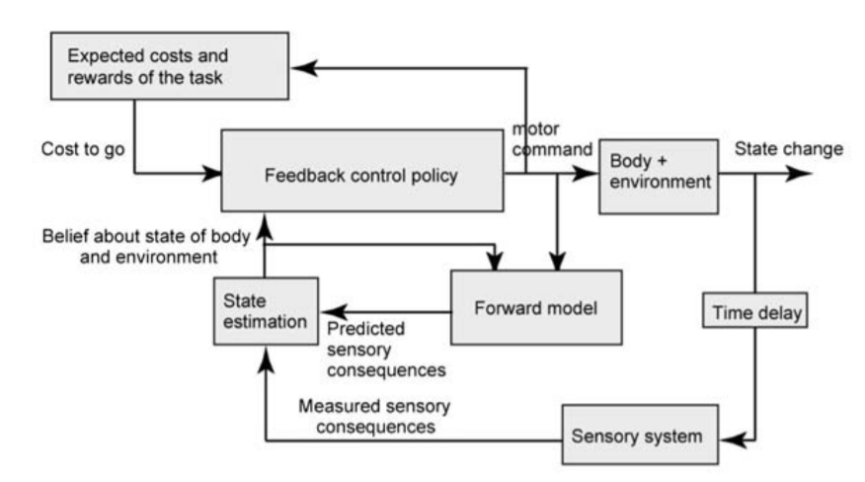
Computational model of reach movement - LQG
Linear dynamical system
Muscle model
State space representation
ẋ
ẏ
ẍ
ÿ
ḟx
ḟy
x
y
ẋ
ẏ
fx
fy
=
A
B
ux
uy
+
x_{k}
A
u
B
X_{k+1}
x_{k}
y_{k}
A
u
B
X_{k+1}
H
x_{k}
H
ỹ_{k}
K
y_{k}
Shadmehr,Krakeur (2008)

Slide 13
Computational model of reach movement - LQG
State space representation
Start-end coordinate /initial state
(x_{start},y_{start}, x_{end},y_{end})
Motor command vector (Ux,uy)
Trajectory dynamics
(ẋ,ẏ,ẍ,ÿ,ḟx,ḟy)
ẋ
ẏ
ẍ
ÿ
ḟx
ḟy
x
y
ẋ
ẏ
fx
fy
=
A
B
ux
uy
+

Slide 14
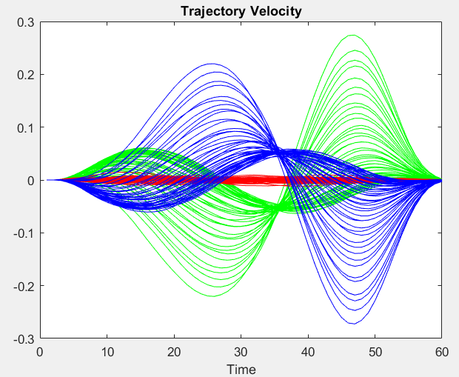
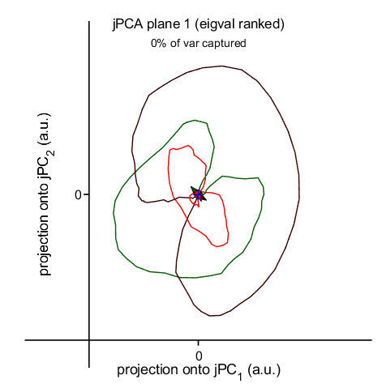
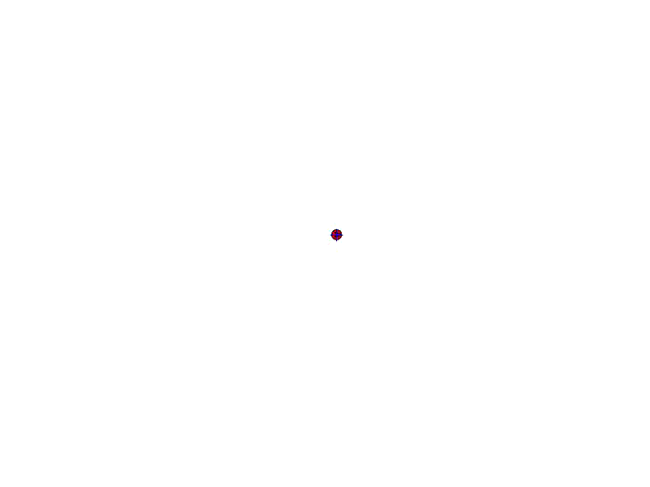
Rotational dynamics in PCA space for the computational models
CCW
CW
Baseline CW CCW

Slide 15
Hand reaching movements : Neural nets / Brain
Input
Mathematical model
LQG controller
Output
Coordinates
Hand trajectory
Input
Output
Synthetic data
Simulated behavior

Slide 16
Today’s talk
Introduction
Previous works
Synthetic data from computational model simulations
Neural data from deep brain recordings
Synthetic Data - Simulated reach parameters using LQG
CNN-Auto decoder model for reach trajectory generation
Auto encoding & decoding
CNN- LSTM model for reach trajectory generation
Open loop
Closed loop with sensory feedback and offline adaptation
Closed loop with sensory feedback and online adaptation
Neural data / Implementation
Summary

Slide 17
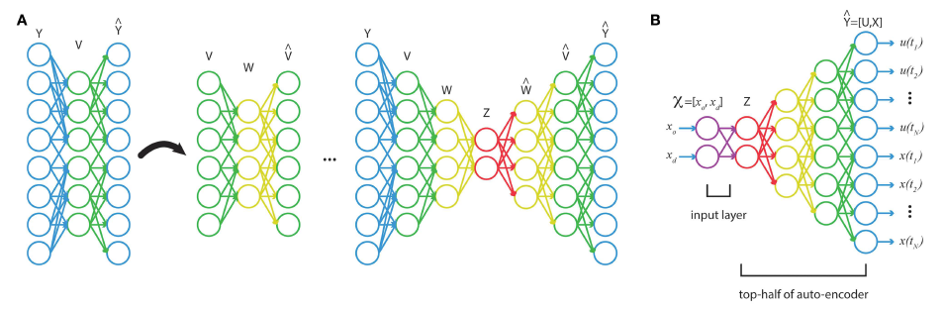
Deep Neural Nets :Auto decoder nets for motor control functions
Autoencoding – dimension reduction technique
With initial and target states as inputs, deep network can be trained to output an accurate temporal profile of the optimal command and state trajectory
A simple example
600ms
600
400
400
100
600
400
100
10
4 10 100 400 600
Bernicker & Kording (2015)

Slide 18
CNN – Auto decoder model
Visual pathways
Start-End
coordinates
CNN
Task Image

Slide 19
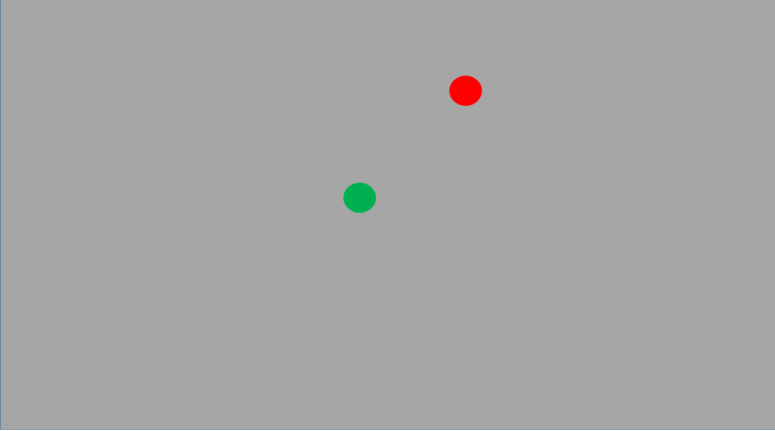
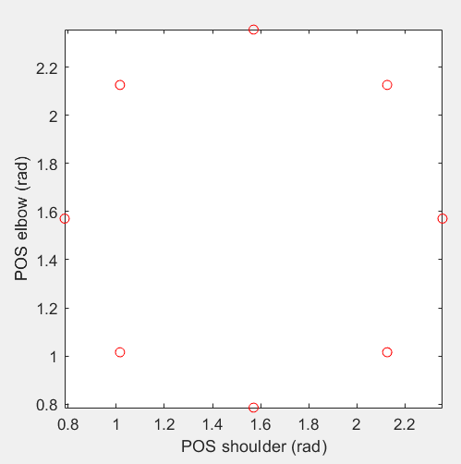
CNN – Auto decoder model
Extrinsic work space
Intrinsic joint space
CNN
……….
8 target locations
Training 20 images per position
CNN training
layers = [ ...
imageInputLayer([28 28 1])
convolution2dLayer(12,25)
reluLayer
fullyConnectedLayer(4)
regressionLayer];

Slide 20
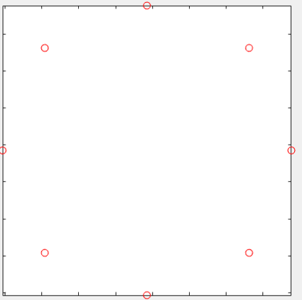
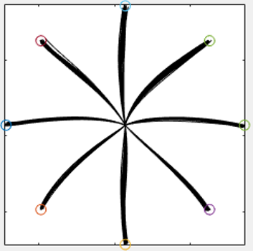
CNN – Auto decoder model
Dimension reduction
Supervised training
Linear Dynamical
System
LQG
Auto decoder NN
Auto encoder NN
Visual pathways
Spinal & muscular level
Input:
Start-End
coordinates
Autodecoder
Net
Output:
Joint velocity
CNN
Input:
Task Image
Output:
Movement trajectory

Slide 21
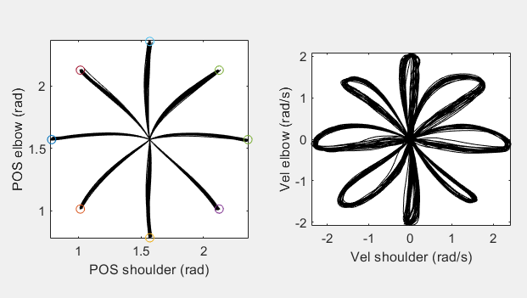
CNN – Auto decoder model
Simulated hand movements in 8 directions : Input data for autoencoding
Linear Dynamical Network
LQG
Todorov, E. and Li, W. (2005)
Input matrix dimension:
(51 xPos Shoulder,51 xPos Elbow,51 Vel Shoulder, 51 Vel Elbow, 51 Control command Shoulder, 51 Control command Elbow) * (20trials*8direction) =
304 * 160

Slide 22
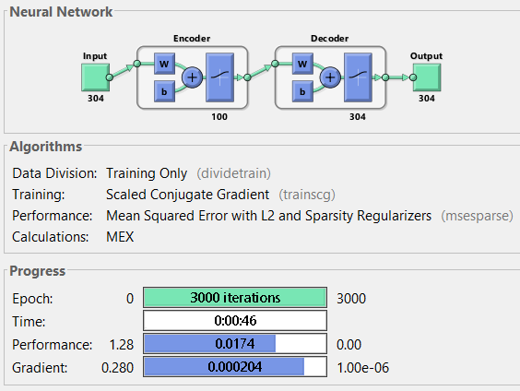
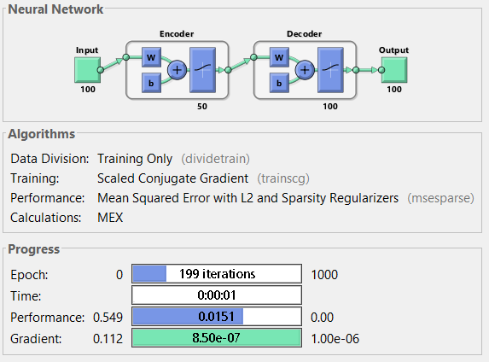
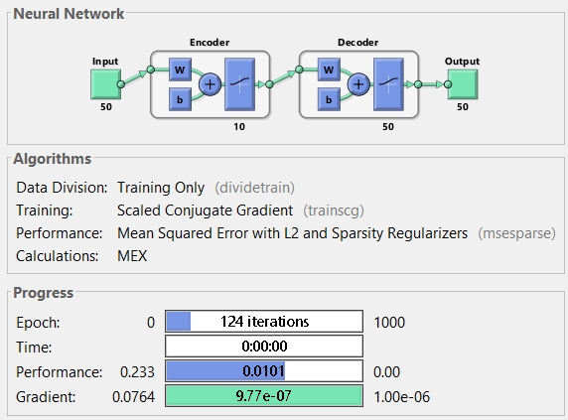
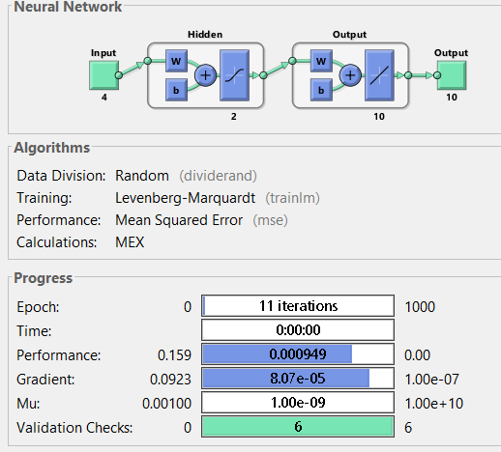
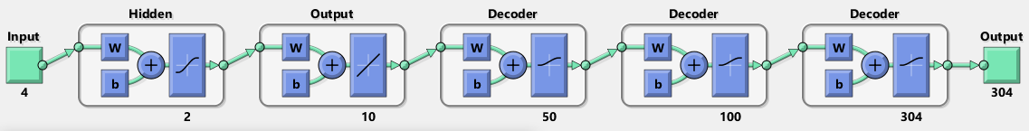
Trajectory velocity : Deep net auto encoder-decoder training
AutoEncoder1
AutoEncoder2
AutoEncoder3
Feedforward net
Fully stacked layer
X, Y
Start,end
Shoulder,elbow,
pos, vel, motor command

Slide 23
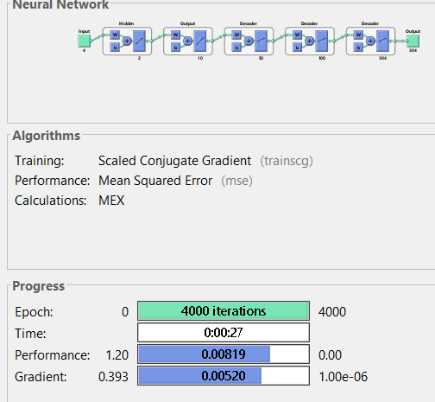
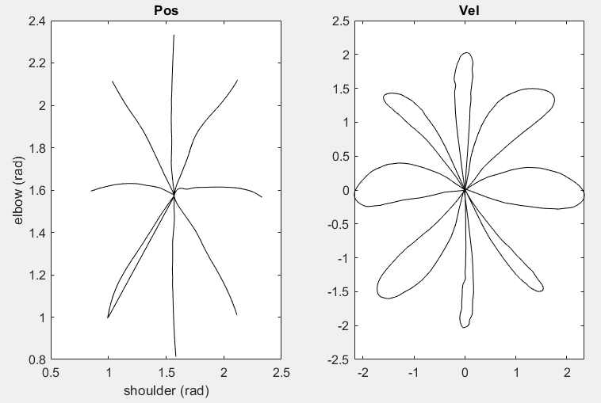
Joint angle to trajectory velocity : Fully stacked autodecoder network training
Train fully stacked layer
Visualize decoded test data

Slide 24
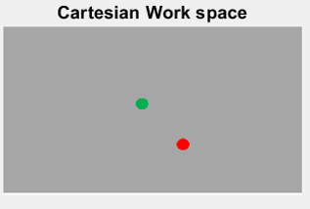
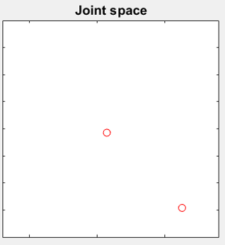
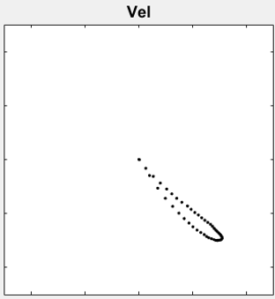
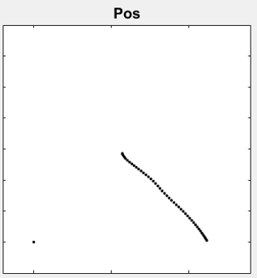
CNN-Auto decoder network model of reach movement generation
CNN
Autodecoder
Net
Visual pathways
Autodecoder
Net
Spinal & muscular level
Start-End
coordinates
Joint velocity
CNN
Task Image
Movement trajectory

Slide 25
Today’s talk
Introduction
Previous works
Synthetic data from computational model simulations
Neural data from deep brain recordings
Synthetic Data - Simulated reach parameters using LQG
CNN-Auto decoder model for reach trajectory generation
Auto encoding & decoding
CNN- LSTM model for reach trajectory generation
Open loop
Closed loop with sensory feedback and offline adaptation
Closed loop with sensory feedback and online adaptation
Neural data / Implementation
Summary

Slide 26
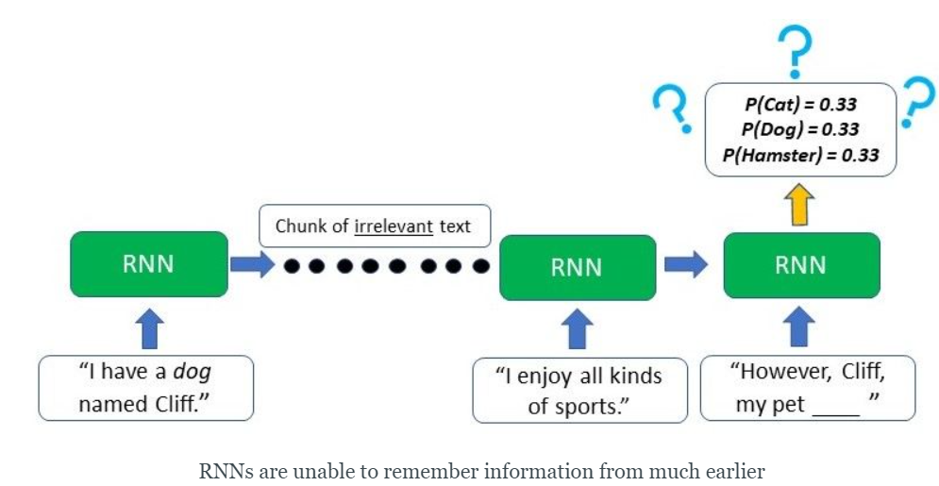


Benefits of Long Short Term Memory (LSTM) nets

Slide 27




CNN-LSTM RNN network model of reach movement generation
LSTM architecture: sequenceInputLayer -> bilstmLayer -> fullyConnectedLayer -> regressionLayer
CNN
LSTM
Visual pathways
LSTM RNN
Net
Spinal & muscular level
Start-End
coordinates
Joint velocity
CNN
Task Image
Movement trajectory

Slide 28
CNN-LSTM network model of reach movement with sensory feedback and adaptation
Spinal & muscular level
Start-End
coordinates
Visual pathways
LSTM₁
Control signal
LSTM₂
Control signal
LSTM₃
Joint velocity
Inter trial updation
CNN
Perturbation
FB Error signal
Task Image
FB Control
signal
LSTM₄
FB Joint velocity
Movement trajectory
Sensory Feedback

Slide 29









CNN-LSTM network model :Simulation- offline adaptation
Visual Stimuli
Start-end points X-Y
Control Signal X
Control Signal X
Velocity X
Position X-Y
CNN
LSTM₁
LSTM₂
LSTM₃
Inter trial updation
FB Error Signal X
FB Control Signal X
FB Velocity X
FB Position X-Y
LSTM₄

Slide 30







CNN-LSTM network model :Simulation- offline adaptation
Visual Stimuli
Start-end points
Control Signal
Control Signal
Velocity
Position
CNN
LSTM₁
LSTM₂
LSTM₃
Inter trial updation
FB Error Signal
FB Control Signal
FB Velocity
FB Position
LSTM₄

Slide 31







CNN-LSTM network model :Simulation- offline adaptation
Visual Stimuli
Start-end points
Control Signal
Control Signal
Velocity
Position
CNN
LSTM₁
LSTM₂
LSTM₃
Inter trial updation
FB Error Signal
FB Control Signal
FB Velocity
FB Position
LSTM₄

Slide 32



CNN-LSTM network model :Simulation- offline adaptation
Visual Stimuli
Start-end points
Control Signal
Control Signal
Velocity
Position
CNN
LSTM₁
LSTM₂
LSTM₃
Inter trial updation

Slide 33



CNN-LSTM network model :Simulation- offline adaptation
LSTM₂ LSTM₃ LSTM₄ architecture

Slide 34





CNN-LSTM network model :Simulation- offline adaptation
Visual Stimuli
Start-end points X-Y
Control Signal X-Y
Control Signal X-Y
Velocity X-Y
Position X-Y
CNN
LSTM₁
LSTM₂
LSTM₃
Inter trial updation
FB Error Signal X-Y
FB Control Signal X-Y
FB Velocity X-Y
FB Position X-Y
LSTM₄

Slide 35
Feedforward-feedback adaptation
Feedback mediated online correction1
Feedback mediated online correction3
Feedback mediated online correction2
1st 2nd 3rd 4th 5th
1st 2nd 3rd 4th 5th
Feedforward adaptation
Offline update of the controller during the inter-trial time
Feedback adaptation
Online update of the controller during the movement time

Slide 36
CNN-LSTM network model :Simulation- online adaptation
Visual Stimuli
Start-end points X-Y
Control Signal X
Control Signal X
Velocity X
Position X-Y
CNN
LSTM₁
LSTM₂
LSTM₃
Within trial updation
FB Error Signal X
LSTM2 get updated every 200ms with respect to trial error history
FB Control Signal X
FB Velocity X
FB Position X-Y
LSTM₄

Slide 37
CNN-LSTM network model :Simulation- online adaptation
Visual Stimuli
Start-end points
Control Signal
Control Signal
Velocity
Position
CNN
LSTM₁
LSTM₂
LSTM₃
Within trial updation
FB Error Signal
FB Control Signal X
FB Velocity X
FB Position X-Y
LSTM₄

Slide 38
CNN-LSTM network model :Simulation- online adaptation
Visual Stimuli
Start-end points
Control Signal
Control Signal
Velocity
Position
CNN
LSTM₁
LSTM₂
LSTM₃

Slide 39
CNN-LSTM network model :Simulation- online adaptation
Visual Stimuli
Start-end points
Control Signal
Control Signal
Velocity
Position
CNN
LSTM₁
LSTM₂
LSTM₃
Inter trial updation
FB Error Signal
FB Control Signal X
FB Velocity X
FB Position X-Y
LSTM₄

Slide 40



CNN-LSTM network model : Simulation- online adaptation
LSTM2 get updated every 200ms with respect to trial error history
Adapted Control Signal
Adapted Velocity
Adapted Trajectory
Tested LSTM2 get updated every 10ms with respect to trial error history
Increasing updation time – computational cost, need more time -GPU
Check offline & online together? Solution:- parallel computing?

Slide 41
CNN-LSTM network model – Parallel LSTM’s
Inter trial
LSTM_{2a}
Spinal & muscular level
Start-End
coordinates
Visual pathways
LSTM₁
Control signal
Control signal
LSTM₃
Joint velocity
LSTM_{2b}
Within trial
CNN
Task Image
Perturbation
FB Error signal
LSTM₄
FB Joint velocity
FB Control
signal
Movement trajectory
Sensory Feedback

Slide 42




CNN-LSTM network model : Parallel LSTM’s
Updation every 200ms
Parameter updation
Updation every 50ms

Slide 43
Today’s talk
Introduction
Previous works
Synthetic data from computational model simulations
Neural data from deep brain recordings
Synthetic Data - Simulated reach parameters using LQG
CNN-Auto decoder model for reach trajectory generation
Auto encoding & decoding
CNN- LSTM model for reach trajectory generation
Open loop
Closed loop with sensory feedback and offline adaptation
Closed loop with sensory feedback and online adaptation
Neural data / Implementation
Summary

Slide 44

Computational model simulation to neural data
Datasets:
Suresh AK, Besmania et al (2020), Neural population dynamics in motor cortex are different for reach and grasp, eLife
Churchland Shenoy et al(2012) Neural population dynamics during reaching, Nature
Target visual input
Joint space representation
Motor command
Muscle veleocity
M1 data – 8 reach directions

Slide 45
Implementation
Scripting
LQG : Matlab, Python, R
CNN-Auto decoder : Matlab
CNN-LSTM : Matlab (DeepLearning/parallel computingToolbox), Python (Keras, tensorflow, pytorch)
Rotational Dynamics : Matlab (Taken from github, ChurchlandLab)
Available : https://github.com/jamesmathew07
Data:
Churchland, Besmania, Crevecoeur

Slide 46


Summary
CNN-Auto decoder approach for reach trajectory generation
CNN-LSTM model can capture online feedback adaptation characteristics
Parallel computing offers better online adaptation

Slide 47
Next Steps
Mathematical model
LQG controller
OFC, LQG
Reaching/Tracking tasks
Perturbations
Sensory delays
Input
Output
Coordinates
Hand trajectory
Neurophysiology
Neural recordings
EEG,MEG,fMRI,EMG
Input
Output
Visual / neural
Hand behavior
Feedback
Input
Output
Best machine learning techniques
Robotics
Synthetic data
Simulated behavior

Slide 48
Merci Beaucoup

Slide 49


Neuronal Data – EMG relation
Lara, Churchland (2018) NatComm

Slide 50


Spinal level to EMG activation
Sartori et al (2017) Nature

